Slide 1

Overview - Cybersecurity CSX Fundamentals Program
CultureLink – 2019
- Alex Rodas

Slide 2

Introductory Bio

Slide 3
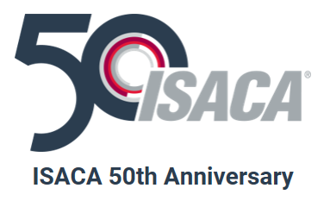
ISACA Background
Established 1969
ISACA has a presence in more than 180 countries, including more than 217 chapters and offices in both the United States and China
ISACA offers the Cybersecurity Nexus™, a comprehensive set of resources for cybersecurity professionals
COBIT 2019 – Business Framework that helps with Governance
CEGIT, CISM, CISA, CRISC (Governance, Security, Audit, Risk)

Slide 4
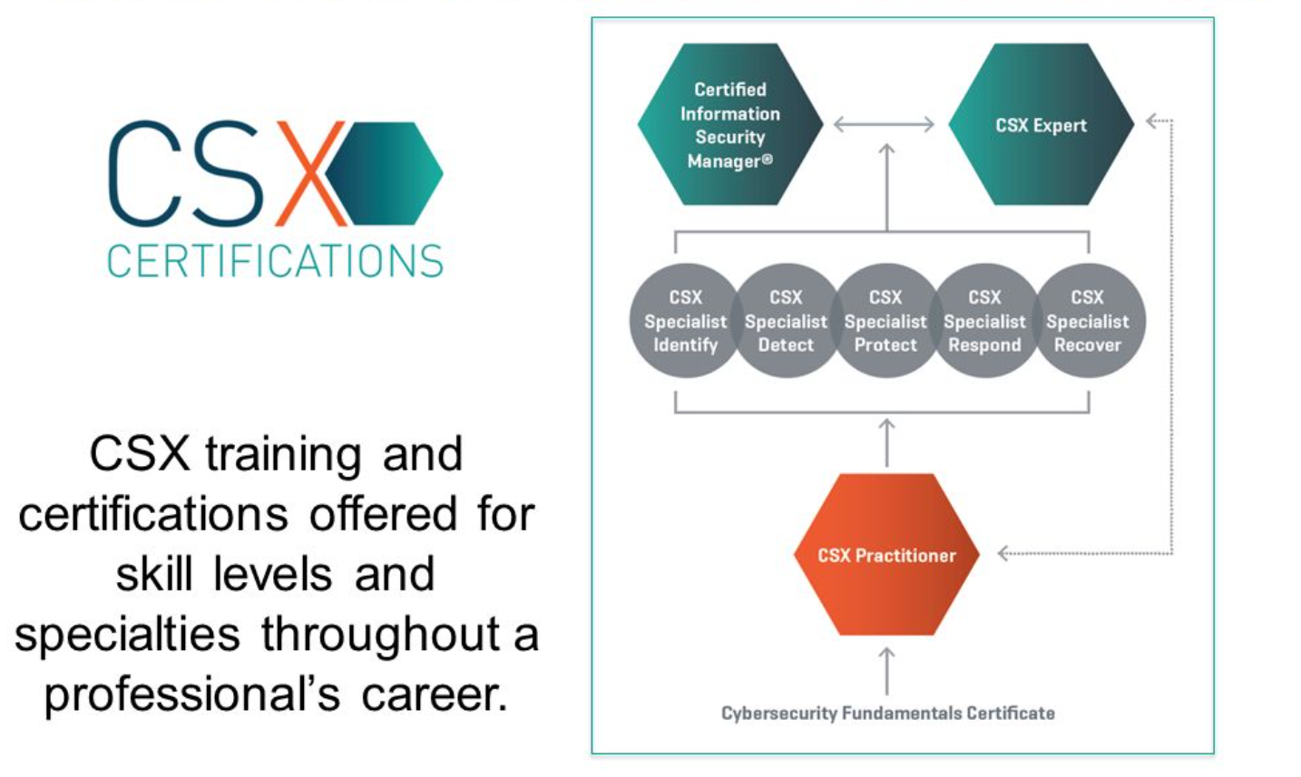
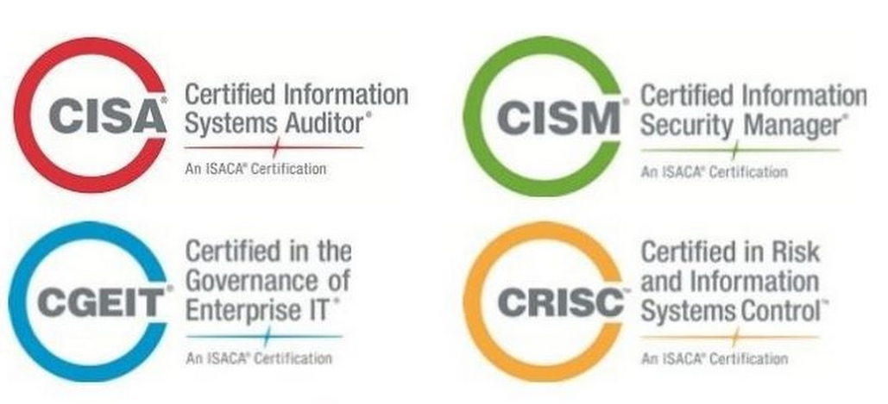

ISACA – CSX Fundamentals

Slide 5
Penetrating the Market
Current status
Where do you want to go?
Make a plan, how to get there
Execute
Set Goals
Learn
Network
Share
Repeat
Don’t give up
Takes time
Be patient
Fundamentals
Concepts
Language
Ideas
Comments
Volunteer
Thank you
ISACA Chapter
Join security networks
LinkedIn
Twitter

Slide 6

Fundamentals - Five Domains
DOMAIN 1
Cybersecurity Concepts
Security Architecture Principles
Security of Networks, Systems, Applications and Data
DOMAIN 4
DOMAIN 5
Incident Response
Security Implications and Adoption of Evolving Technology
DOMAIN 2
DOMAIN 3

Slide 7
8 Week Program
Week 1
Week 2
Domain 1: Cybersecurity Concepts
Week 3
Domain: 2 Security Architecture Principles
Week 4
Domain 3: Security of Networks, Systems, Applications and Data
Week 5
Domain 4: Incident Response
Week 6
Domain 5: Security Implications and Adaptation of Evolving Solutions
Week 7
Review course material
Week 8
Practice Exam
Cybersecurity Introduction and Overview

Slide 8
Domain 1: Cybersecurity Concepts
Cybersecurity principles used to manage risk related to:
Processing
Storage
Transmission of data
Risk Management process (risk, threat, asset, vulnerability)
Security Management (change mgt., config. mgt., access-list)
Threat actors (i.e. script kiddies, nation states, social hackers, etc.)
Cybersecurity roles (Board of Directors, Exec. Mgt., Senior Mgt. Security practitioners)
Cybersecurity controls

Slide 9
Domain: 2 Security Architecture Principles
Understand the principles when designing a network
What are the security and operational objectives?
Security architecture concepts:
What are the security and operational objectives?
Defense in depth tactic
Topologies, protocols
Intrusion detection methodologies (IDS, IPS)
Traffic flows across network

Slide 10
Domain 3: Security of Networks, Systems, Applications and Data
Vulnerability assessment tools, including open source tools
Information testing execution standard
PCI penetration guide
Network system management principles (access-list, hardening of system,etc.)
Remote access technology (VPN, IPSEC, NAC)
Basic UNIX commands
Understand basic network components (hubs, switches, bridges, servers, etc.)
Network topologies, LAN, WAN WLAN

Slide 11
Domain 4: Incident Response
Different phases (Preparation, Detection/Analysis, Containment, Post incident)
Difference between an event vs. incident
Incident response categories (abusive content, fraud, availability, intrusion, etc.)
Business continuity / disaster recovery concepts
Handling of incident response
Common forensic tools and support application (Wireshark, VMware)
Network traffic analysis methods
Logs, registries (filesystem that need protection – Unix / Windows)

Slide 12
Domain 5: Security Implications and Adaptation of Evolving Solutions
Discussion on emerging technologies
IoT
Big data
The risks associated with mobile technology
Cloud concepts around data and collaboration
Risk moving applications and infrastructure to the cloud
Risk associated with outsourcing

Slide 13
8 Week Program
Quizzes / Reviews
Student Current Events
Each student presents a relevant topic regarding security
Goal - > be able to present and discuss, build soft skills
Guest speakers
Entrepreneurs
Blockchain
IoT leaders
Auditing
IT Consultants
Vendors (Microsoft, Cisco, etc.)
Industry leaders

Slide 14
Certification Exam Details
The Cybersecurity Fundamentals Certificate exam is an online
Closed-book, remotely proctored exam.
Covers five domains and includes a total of 75 questions
Each multiple-choice question has four options with only one correct answer. You will be given 2 hours (120 minutes) to complete the exam. The passing score is 65%.

Slide 15
Q & A
Thank you

